Slide 1
IEEE 802.11

Slide 2
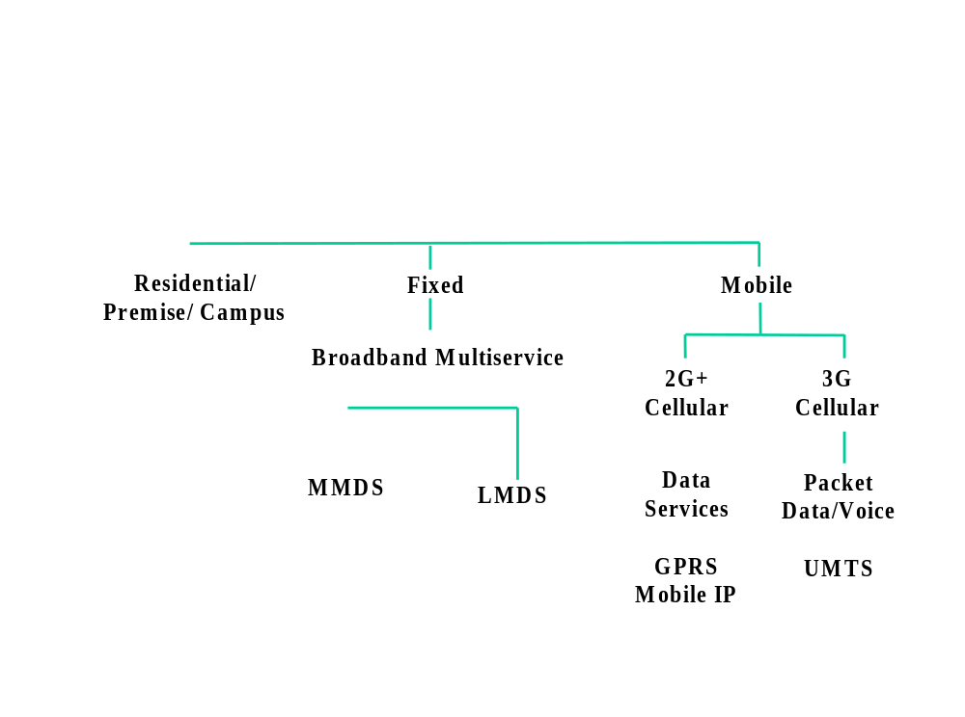
Wireless Market Segments
MMDS=Multichannel multipoint Distribution System
LMDS=Line of sight to Multipoint
UMTS- Universal Mobile Telecommunication Systems

Slide 3
Standardization of Wireless Networks
Wireless networks are standardized by IEEE.
Under 802 LAN MAN standards committee.
Application
Presentation
ISO
OSI
7-layer
model
Session
IEEE 802
standards
Transport
Network
Logical Link Control
Data Link
Medium Access (MAC)
Physical
Physical (PHY)
Notes:
Same organization that came up with IEEE 802.3 Ethernet,
which is responsible for success of Internet

Slide 4
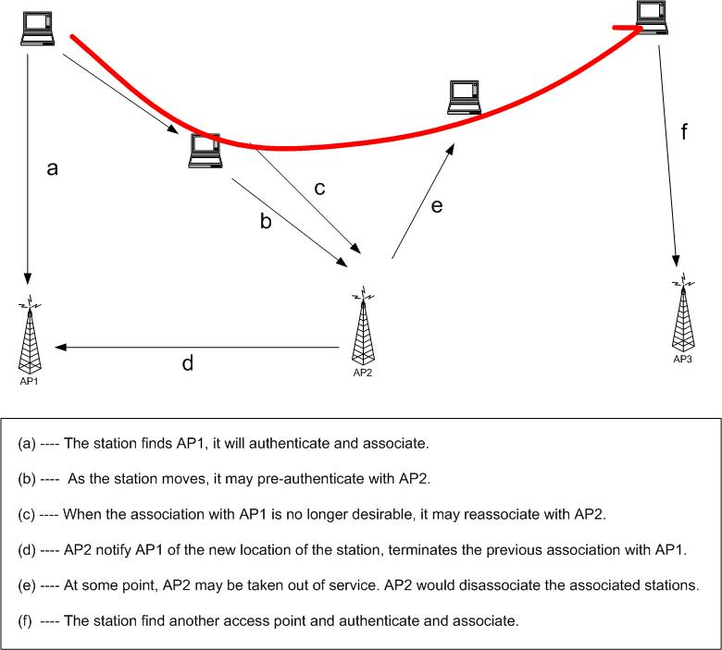

Slide 5
Frame Types
NAV information
Or
Short Id for PS-Poll
Upper layer data
2048 byte max
256 upper layer header
FC(Frame
control)
Duration
/ID
Address
1
Address
2
Address
3
Sequence
Control
Address
4
DATA
FCS
2 2 6 6 6 2 6 0-2312 4 bytes
Protocol Version
Frame Type and Sub Type
To DS and From DS(Distributed System)
More Fragments
Retry
Power save-1 Management
More Data
WEP(Encryption-1)
Order Sequence
IEEE 48 bit address
Individual/Group
Universal/Local
46 bit address
MSDU(MAC Service Data unit)
Sequence Number
Fragment Number
CCIT CRC-32 Polynomial
BSSID –BSS Identifier
TA - Transmitter
RA - Receiver
SA - Source
DA - Destination

Slide 6
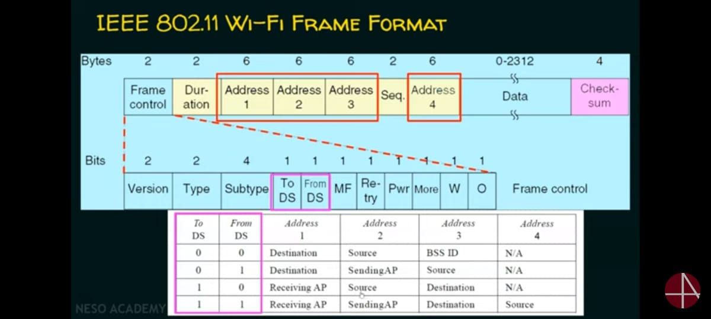
AP ACCESS POINT

Slide 7
MAC Management
Interference by users that have no concept of data communication. Ex: Microwave
Interference by other WLANs
Security of data
Mobility
Power Management

Slide 8
IEEE 802.11 Protocols
  IEEE 802.11a
    PHY Standard : 8 channels : 54 Mbps : Products are available.
  IEEE 802.11b
    PHY Standard : 3 channels : 11 Mbps : Products are available.
  IEEE 802.11d
    MAC Standard : operate in variable power levels : ongoing
  IEEE 802.11e
    MAC Standard : QoS support : Second half of 2002.
  IEEE 802.11f
    Inter-Access Point Protocol : 2nd half 2002
  IEEE 802.11g
    PHY Standard: 3 channels : OFDM and PBCC : 2nd half 2002
  IEEE 802.11h
    Supplementary MAC Standard: TPC and DFS : 2nd half 2002
  IEEE 802.11i
    Supplementary MAC Standard: Alternative WEP : 2nd half 2002

Slide 9
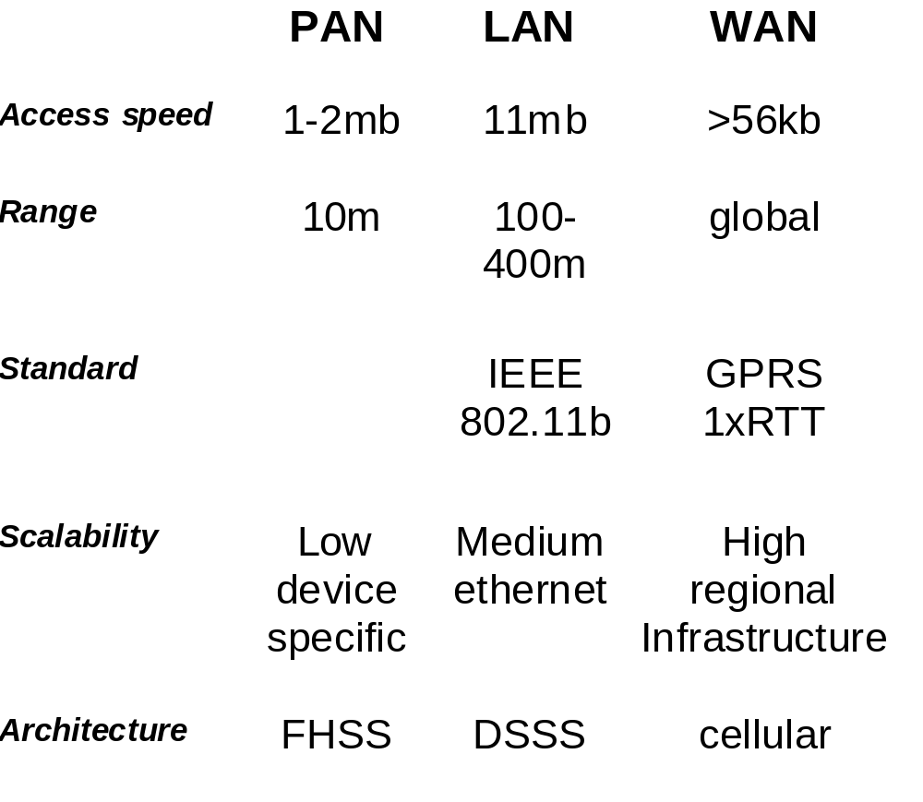
The Basics of WLANs

Slide 10
Frequency Bands- ISM
Industrial, Scientific, and Medical (ISM) bands
Unlicensed, 22 MHz channel bandwidth
Short Wave Radio
FM Broadcast
AM Broadcast
Television
Infrared wireless LAN
Audio
Cellular (840MHz)
NPCS (1.9GHz)
Extremely
Low
Very
Low
Low
Medium
High
Very
High
Ultra
High
Super
High
Infrared
Visible
Light
Ultra-
violet
X-Rays
902 - 928 MHz
26 MHz
2.4 - 2.4835 GHz
83.5 MHz
(IEEE 802.11)
5 GHz
(IEEE 802.11)
HyperLAN
HyperLAN2

Slide 11
Overview, 802.11 Architecture
ESS
Existing Wired LAN
AP
AP
STA
BSS
STA
STA
BSS
STA
Infrastructure Network
STA
STA
Ad Hoc Network
BSS
BSS
Ad Hoc Network
STA
STA
BSS-basic service set
STA-stations

Slide 12
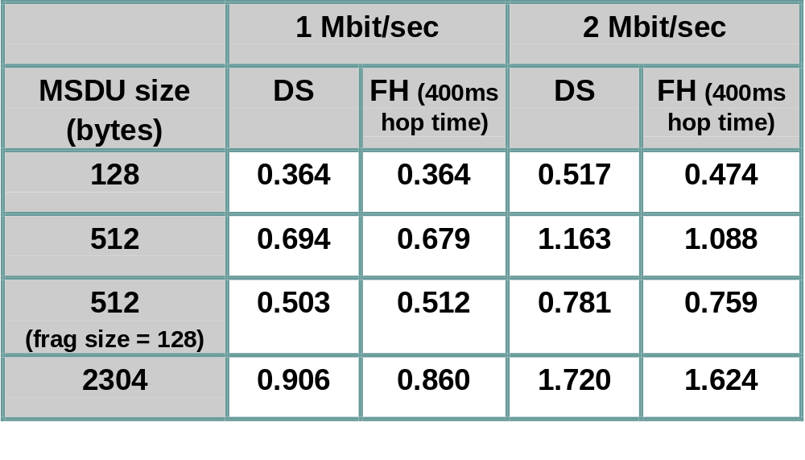
Performance, Theoretical Maximum Throughput
Throughput numbers in Mbits/sec:
  Assumes 100ms beacon interval, RTS(Request to send , CTS(Clear to send) used, no collision(CSMA-CA- Collision Avoidance)
  Slide courtesy of Matt Fischer, AMD
MSDU-MAC service data unit

